Slide 1

Admin Architects - Fennex ROI Calculator
A presentation by Andrew, Jack, Martin, Ostin and Rylan

Slide 2
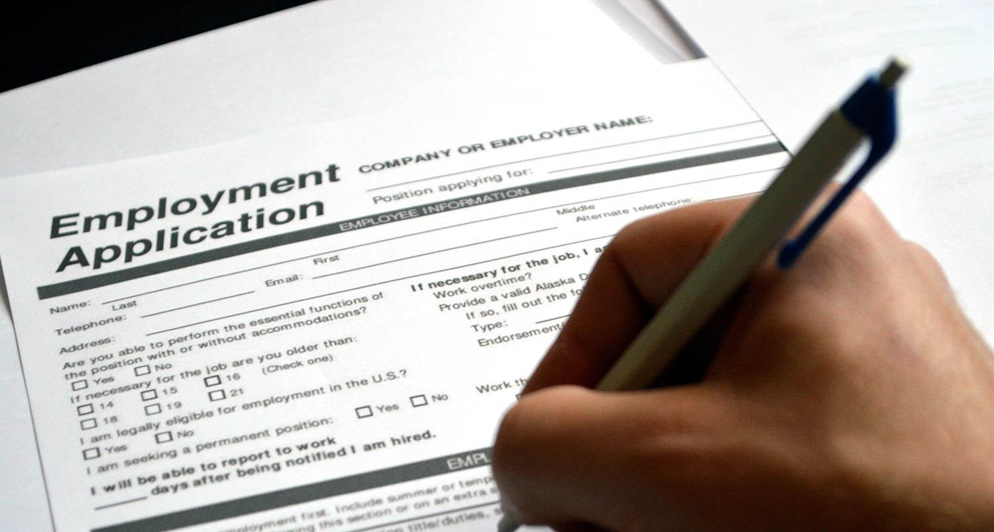
The Problem

Slide 3

The Solution

Slide 4
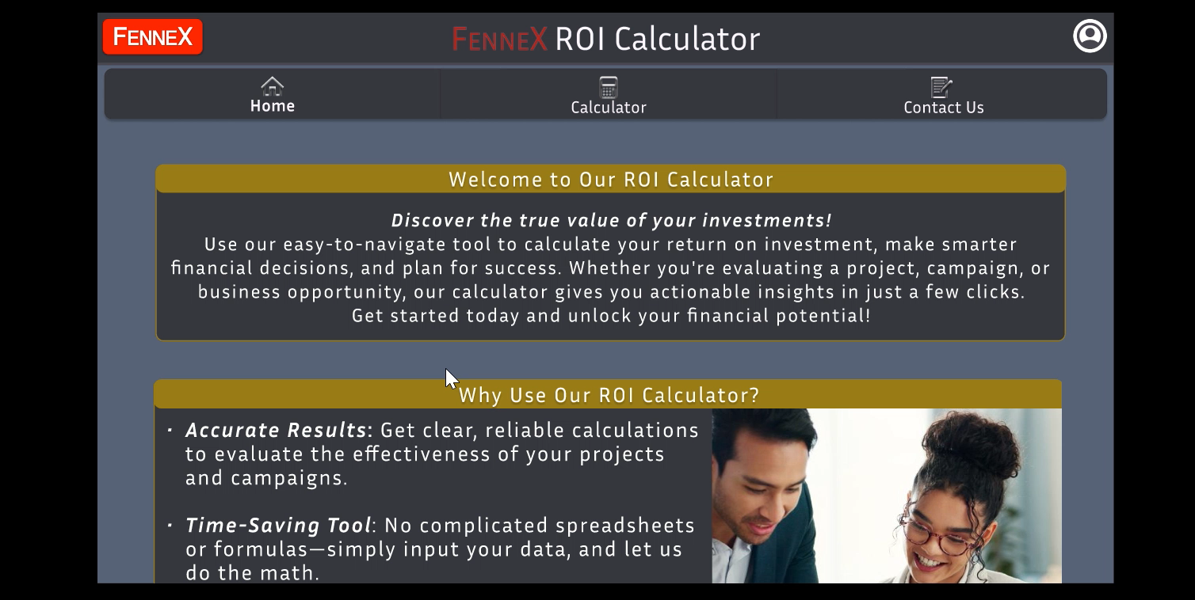
Demo Video

Slide 5
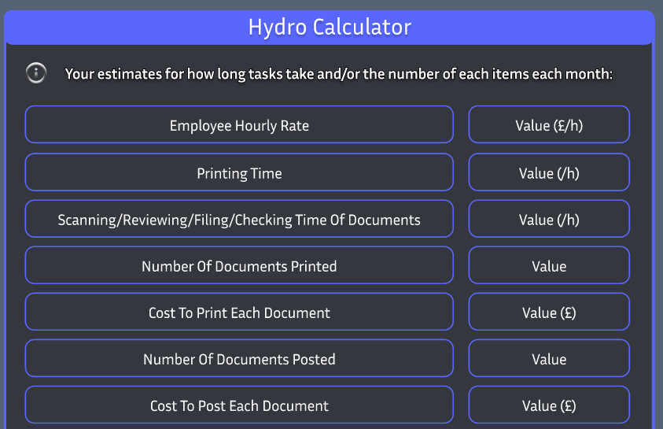
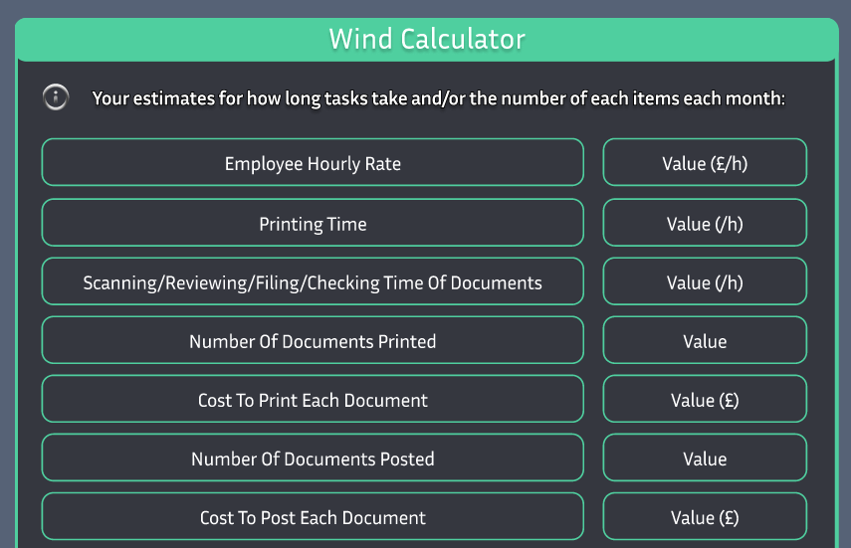
Calculator

Slide 6
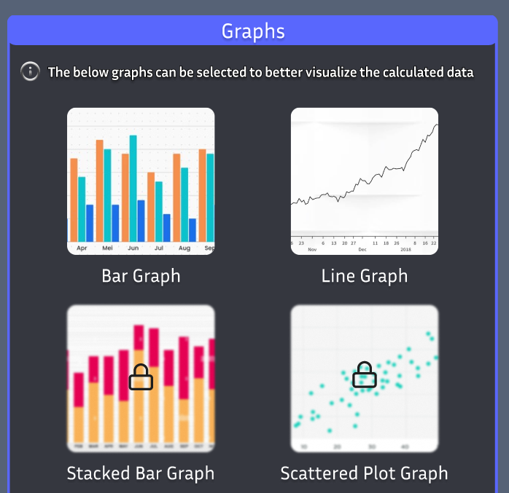
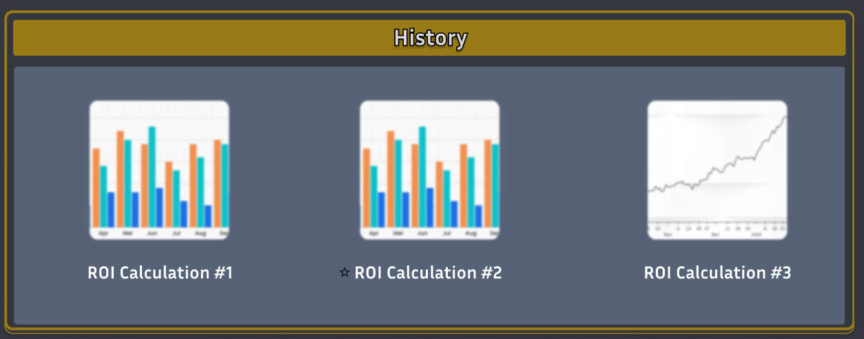
Graphs

Slide 7

Free Plan
Basic Graph Display Options
Limited Calculations Allowed Per Day
Only The Latest Three Calculations Per Day

Slide 8

Premium Plan
Additional Advanced Graph and Chart Display Options
All Calculations Stored Using Microsoft Azure Cloud Storage
Unlimited Calculations Allowed Per Day

Slide 9
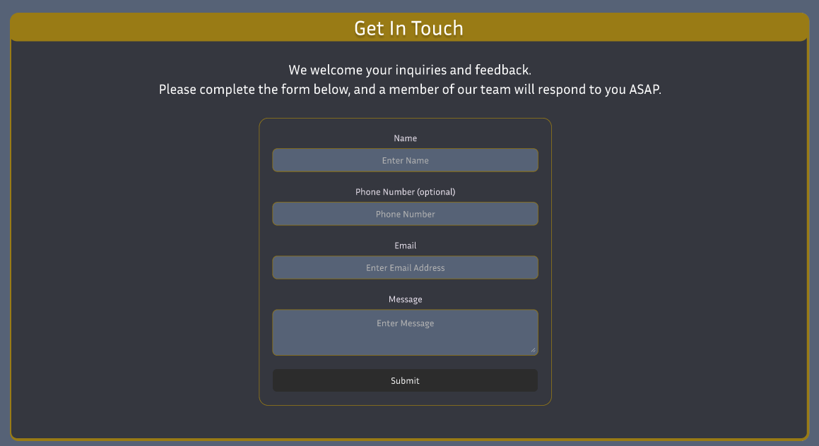
Contact Us

Slide 10
